Slide 1
EDDI Structural Design Criteria – Enhanced Content & Usability– CCFE (2016). Priority gap : development of Elasto-Plastic Plastic Flow Localisation Rules
WPMAT
Deliverable ID: MAT-1.3.2-T007-D003
Yong Xue, CCFE
M. Fursdon, CCFE

Slide 2

MAT-1.3.2-T007-D001
5 year Objective
WBS1.3.2 – Enhancing Content and Usability : Remove potential inaccuracies in existing elastic FE based rules by creating elasto-plastic methods/rules
2016 tasks in TS
Adopt cyclic (strain?) softening material modelling technique developed in the Ratcheting task.
Propose a rule modification that removes the need for linearisation.
Perform an assessment demonstrating comparing original rule results with the improved rule (including the cyclic softening model).
Deliverable(s):
Summary overview report on enhanced content & usability– Plastic Flow Localisation for year 2016
Acceptance Criteria:
Deliverable(s) to be issued and approved through EUROfusion IDM

Slide 3
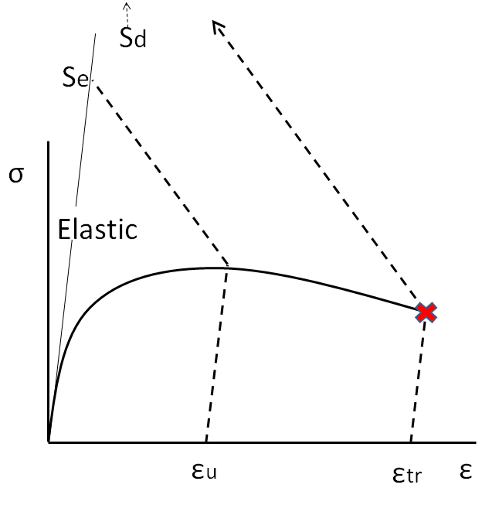

MAT-1.3.2-T007-D001 Flow localisation
Introduction
Flow localisation rule assesses if limit of uniform elongation is reached (ε_{u}) i.e to prevent risk of necking
In elastic FEA, plastic strain is extrapolated to an equivalent Stress (Se) and linearisation at stress concentration is used
DDC will replace this with explicit calculation of elastic+plastic strain to make direct compariosn with ε_{u}
Same methodology is also applied to replace existing elastic Exhaustion of ductility rule (uses extarpolation stress S_{d})

Slide 4
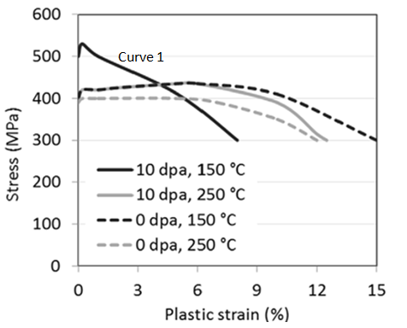
MAT-1.3.2-T007-D001 Flow localisation
Proposed elasto-plastic methods needs to capture all types of expected stress strain curves
Some materials after irradiation show zero uniform elongation strain but have potentially usable strain before rupture (assuming level of flow localisation is acceptable)
New assessment rule aims to capture strain up to uniform elongation limit and if possible usable strain up to limit of exhaustion of ductility – requires necking/strain softening simulation
From Finici et al

Slide 5
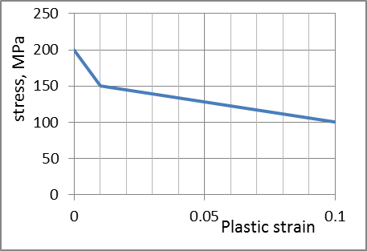
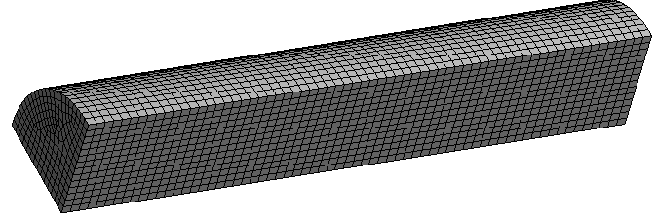
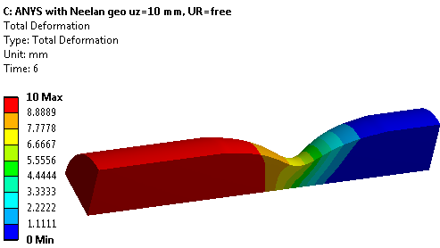
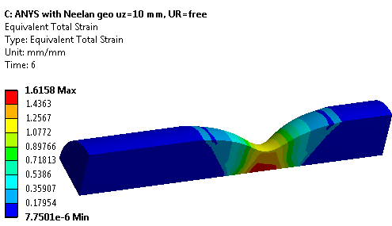
MAT-1.3.2-T007-D001 Flow localisation
Scripts have been written to allow simulation of severe softening in ANSYS

Slide 6
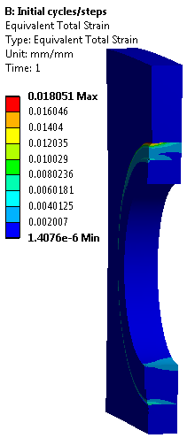
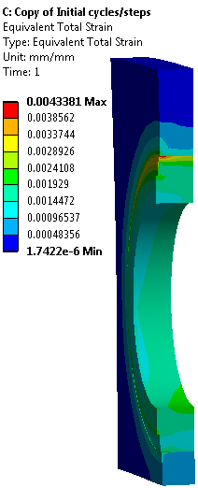

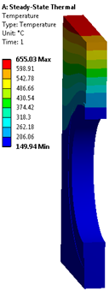
MAT-1.3.2-T007-D001 Flow localisation
Application to real PFC geometry
Example geometry taken from ITER like divertor target
With hardening model
With softening model

Slide 7
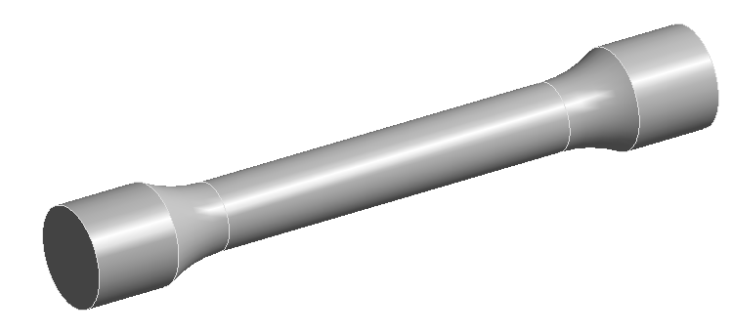
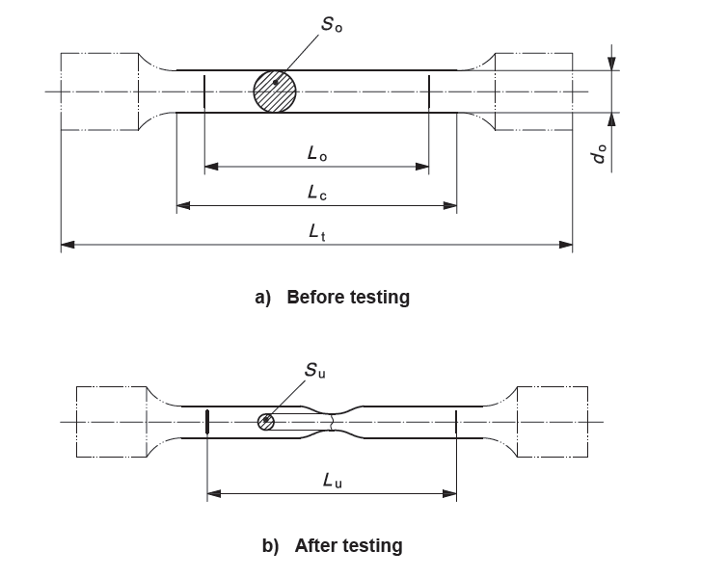
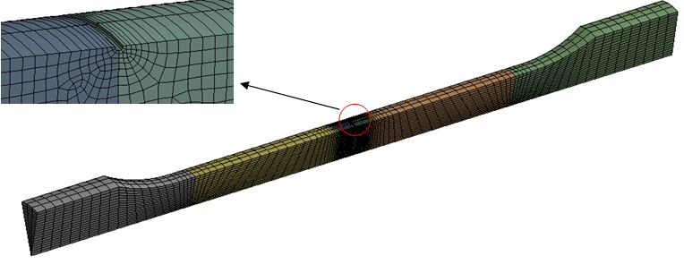
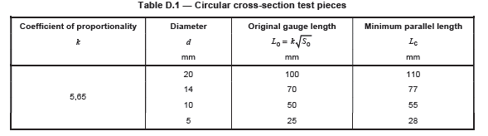
MAT-1.3.2-T007-D001 Flow localisation
Study made this year to convert published Engineering Test data of (potentially) necked samples to real stress/strain data for analysis input

Slide 8

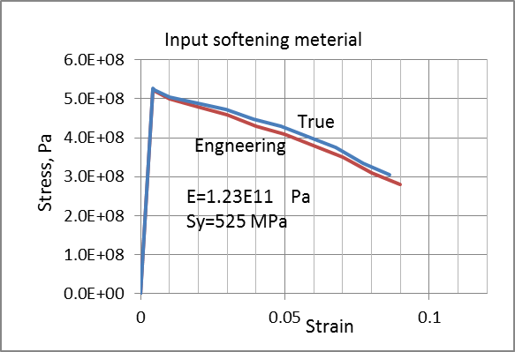
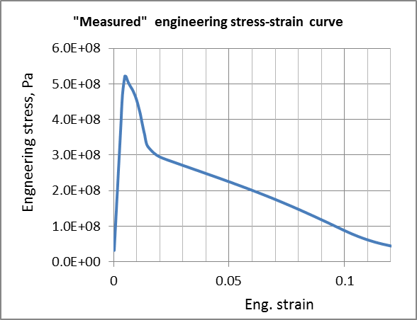

MAT-1.3.2-T007-D001 Flow localisation
Attempt was made to fit Finici softening data
Normal practice is to apply eng/true correction
Resulting simulated “measured data” (following test measurement method) does not match published results
Input data True σ-ε as Finici
Calculated output using test measurement method

Slide 9
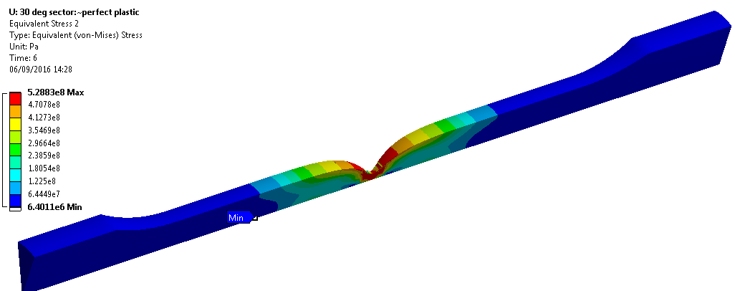
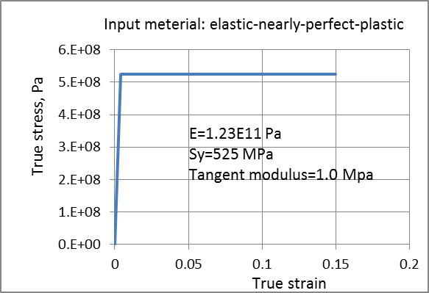
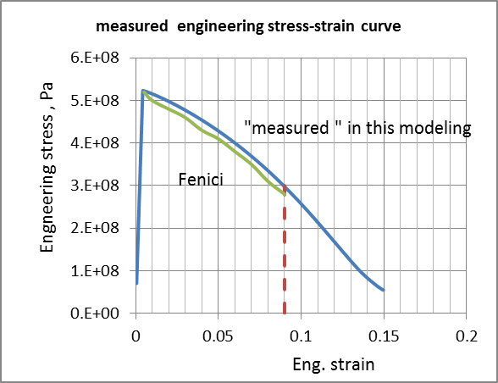
MAT-1.3.2-T007-D001 Flow localisation
Better fit to Finici Softening data (assuming standard test used) is achieved by input of elastic perfectly plastic (non-softening) material
Use of gauge length over necked and un-necked material leads to “illusion” of softening behaviour.

Slide 10
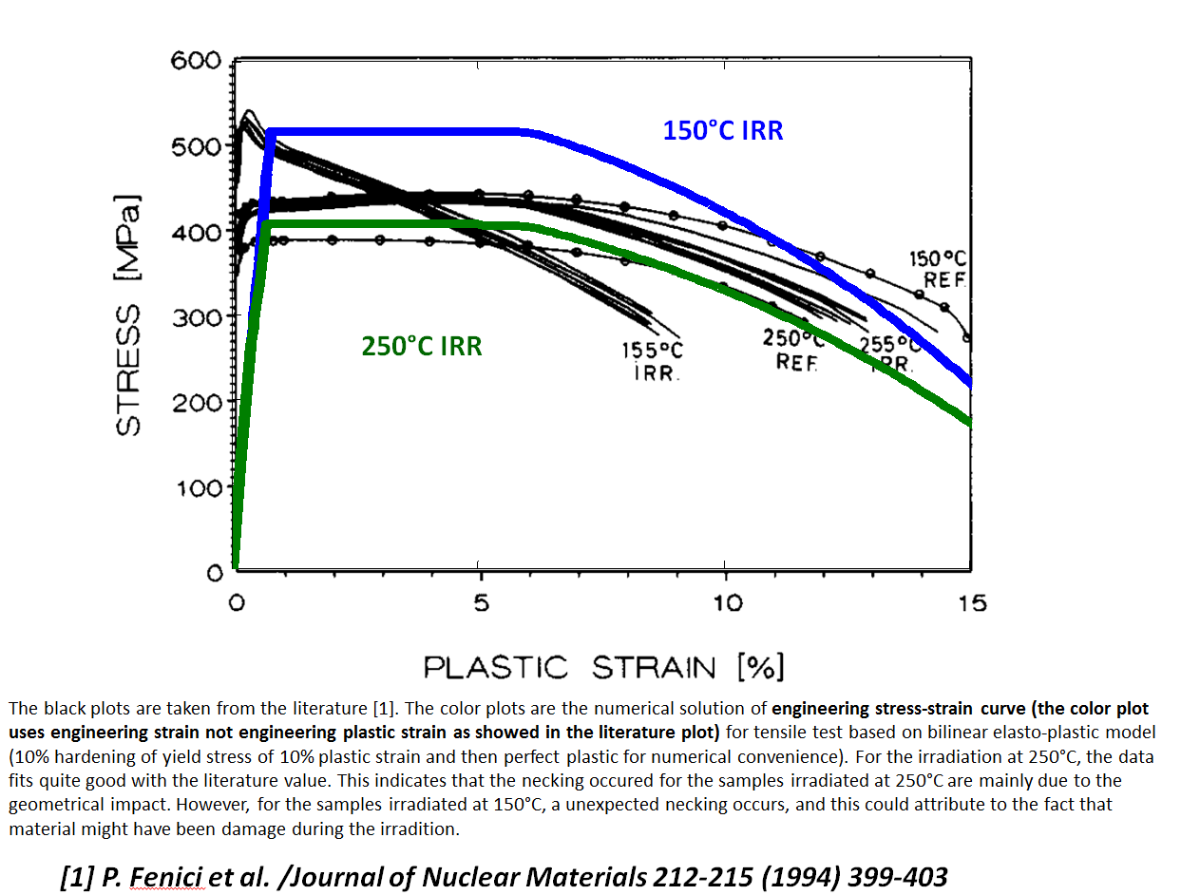
MAT-1.3.2-T007-D001 Flow localisation
Similar conclusion from work at IPP [M.Li, Y.You]

Slide 11
MAT-1.3.2-T007-D001 Flow localisation
Simulating Un-irradiated Irradiated material conditions
To capture all usage of available strain (up to ε_{u} & ε_{tr}), strain used during manufacture will be included in assessment/rule.
(simulations have both manufacturing step followed by operating conditions step)
Clearly irradiated material properties are not relevant to manufacturing so the ideal is to switch from un-irradiated to irradiated material properties with simulation process.
? Is this feasible – this is yet to be determined.
Fall back might be to just apply irradiated to manufacturing cycle – should be conservative – but might be too conservative.

Slide 12
MAT-1.3.2-T007-D001 Flow localisation
Conclusion
Results suggest elasto-plastic simulation of full stress strain curve up to rupture is possible even under severe strain softening conditions.
Softening materials in real geometries can be simulated.
So … existing elastic Flow localisation and Exhaustion of ductility rules can be replaced by rules using explicit evaluation of plastic strain (up-to and beyond uniform elongation/necking limit) for comparison with true material limit ε_{tr}.
Standard test methods can give false indication of softening behaviour
To be done:
Write rule to capture the techniques shown
Compare new method with elastic FEA (with linearisations)

Slide 13
MAT-1.3.2-T007-D001
Review: Objectives-Status for the 5 year period
5 year Objective(s):
WBS1.3.2 – Enhancing Content and Usability “… Plastic Flow Localisation. Remove potential inaccuracies in existing elastic FE based rules by creating elasto-plastic methods/rules
Achievements/Status:
Strain softening modelling method devised for ANSYS
Reported strain softening data re-characterized as strain hardening
Proposed rule method applies to Flow localization and Exhaustion of ductility
To be done:
Writing of flow localization (and associated exhaustion of ductility) rule
Assessment comparing original and improved rule
Potential Failure:
Feasibility/need to simulate switch from un-irradiated to irradiated material TBC
Outlook:
Rule expected to be delivered by 2018
Devise method to switch from un-irradiated to irradiated if possible.

Slide 14
MAT-1.3.2-T007-D001 Flow localisation
References
1. P.Fenici, et al, Effect of fast-neutron irradiation on tensile properties of precipitation-hardened Cu-Cr-Zr alloy, Journal of nuclear materials, 212-215, (1994) 399-403.

Slide 15
Your report starts here …
Important Notes:
Prepare two Powerpoint files:
(A) one for the monitoring meeting and
(B) one for the final reporting (later)
(A) for monitoring
Reduce the number of slides for the Monitoring Meeting to meet the schedule &
Try to describe in brief
Keep the information consice, omit too detailed/specific information and data
(B) for reporting
For the Deliverable Report the number of slides is unlimited
Use the simple filename convention:
Deliverable-ID_TS-Title.ppt(x)
e.g. AS-2.2.2-01_Selection of blablabla.ppt(x)

Slide 16
Mandatory Information includes at least one slide on
Results
Conclusions
Result(s):
The optimum composition w.r.t. HT strength is …
Hot rolling can be performed in the temperature range 720-1060 °C …
Etc.
Conclusion(s):
Which goals/deliverables have been reached?
Which goals/deliverables have not been reached? Why? Actions required or planned?
Comments on the Workplan 2017 and PMP: Is the WP still feasible? Is adjustment required due to your results? What is your outlook?

Slide 17
Midterm–Review: Objectives-Status for the 5 year period
Objective(s):
Review your 5 years objectives (i.e. your offer in answer to the call for participation in 2013/14)
Achievement and status:
Report the achievements
Report as well on failures (long-term as important as appearing all time “brilliant”)
How far are you wrt to schedule (ahead/behind)
Impact on the project
Interaction with other tasks/work-packages ….
Outlook:
Next steps ahead
How do you rate them (eg. challenge/risk)
… other elements you consider important ….
Challenge
Please try:
To write in a language understandable for “upstream”-management
Be critical and honest in front of yourself

Slide 18






















Logos of the official WPMAT participants. Note: Some universities and labs are grouped in certain countries and, therefore, appear officially as only one RU (CIEMATand 2 sections of ENEA). Nevertheless, you are invited to add your own logo!

Slide 19
MAT-1.3.2-T007-D001 Flow localisation
Additional slides

